Slide 1
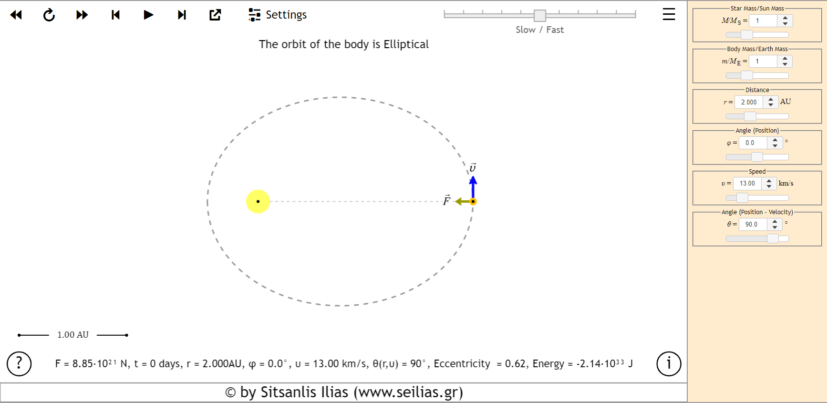
Typical simulation image

Slide 2
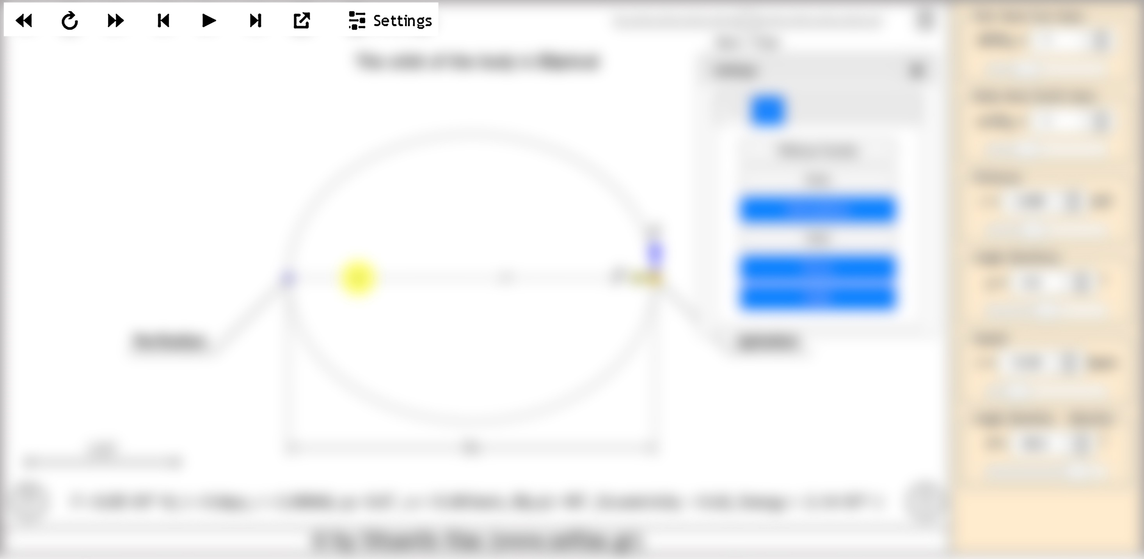
❶ ❷ ❸ ❹ ❺ ❻ ❼ ❽
Slow backward movement: If the button is continuously pressed the simulation is performed, backwards, at a slow rate. The simulation stops when the key is released.
Restart: Reset to initial conditions with the timer showing zero.
Slow forward motion: If the button is continuously pressed the simulation runs forward at a slower rate. The simulation stops when the key is released.
One frame back: If the key is pressed once, then we have a frame backwards. That is, we have the image at the moment in time $t−dt$
Play: The simulation starts running.
One frame forward: If the key is pressed once then we have one frame forward. That is, we have the image at the moment in time $t+dt$
Full Screen: the simulation runs full screen
Settings: Additional settings

Slide 3
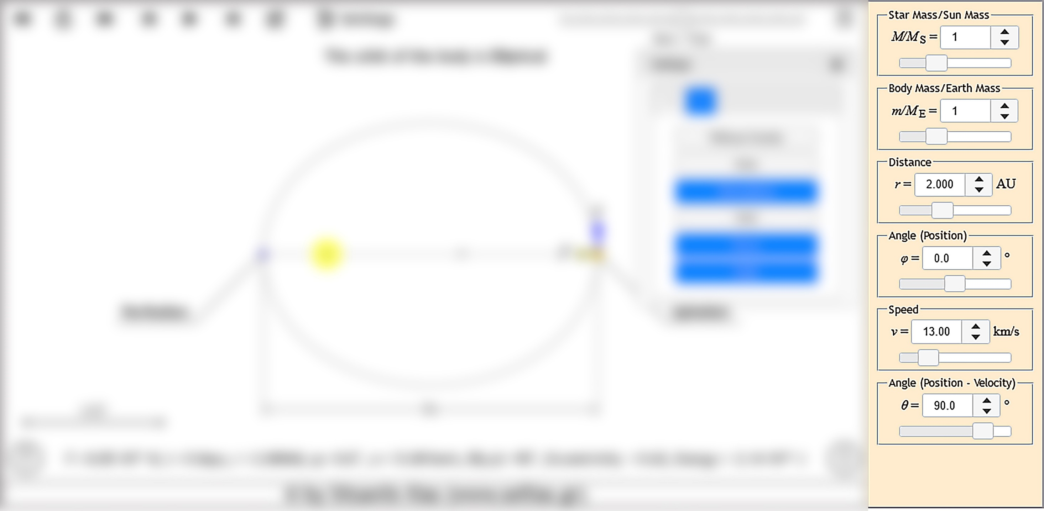
Main configuration window. Parameter values can be entered
By moving the slider
By the spinner
By entering data via keyboard in the text field
In this example we can change the mass of the star, the mass of the planet, the polar coordinates of the planet (distance and angle) and the polar coordinates of the velocity vector (Magnitude and direction).

Slide 4
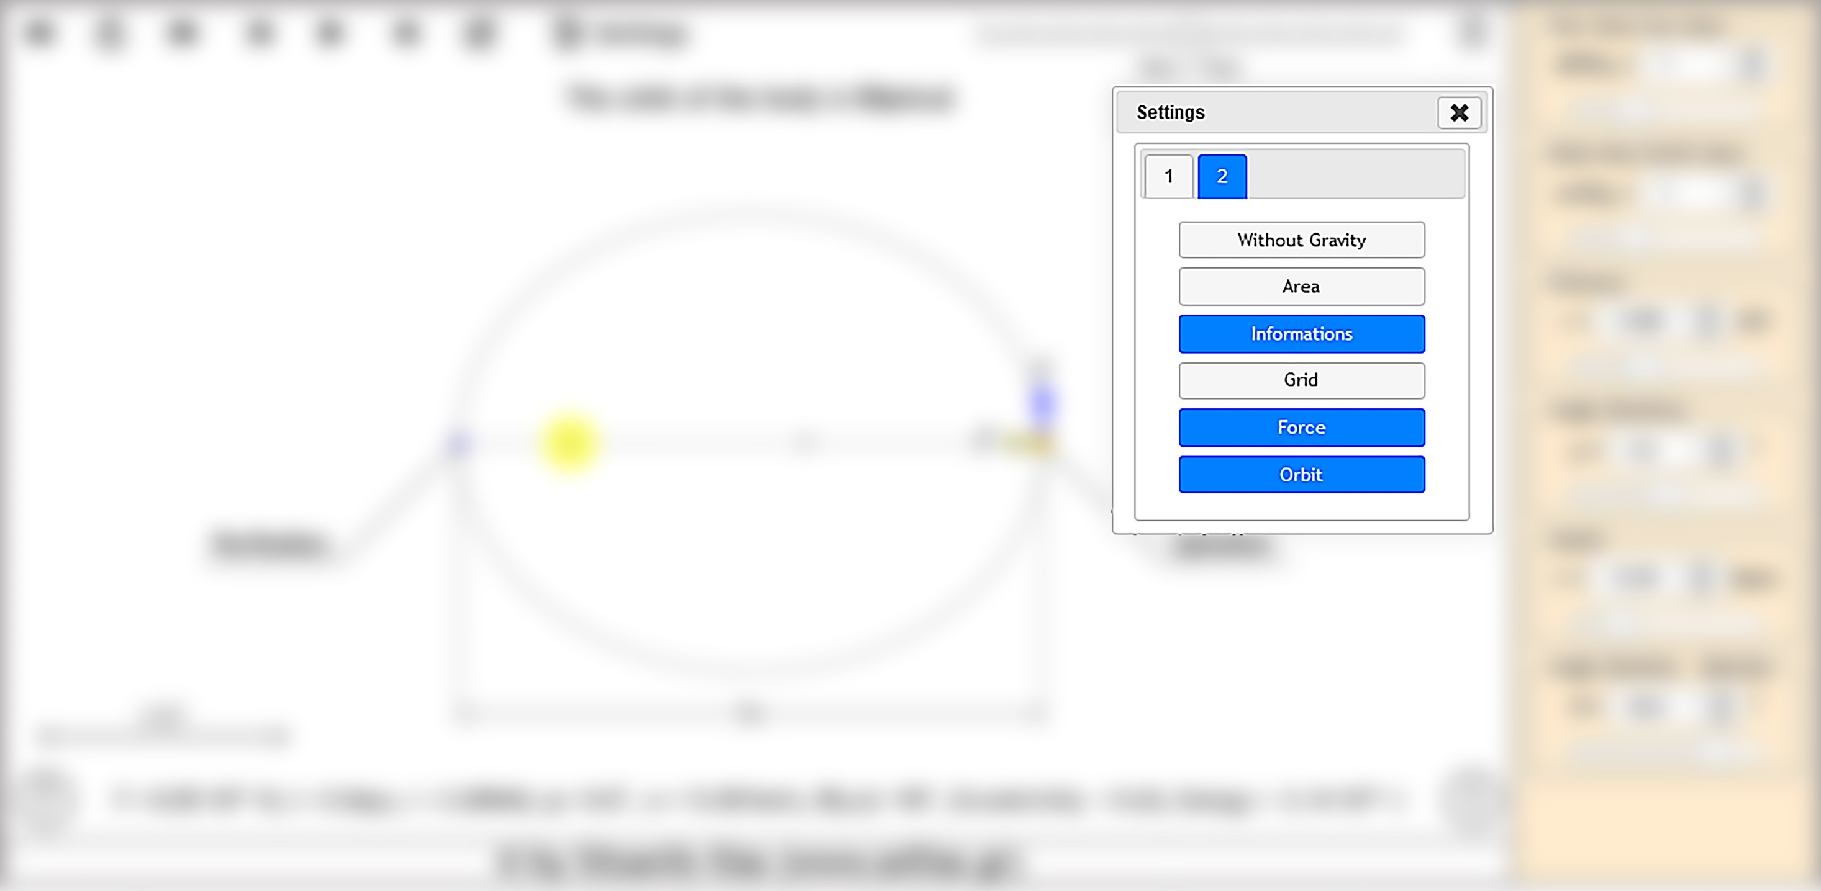
Secondary configuration window. The window is activated by the “Settings" button on the main settings bar we described.
In the window we distinguish two tabs 1,2
In this (2) tab we have the possibility to enable or disable certain options. In this particular example if we choose:
‘Without Gravity’: then the body will continue its motion in a straight line with constant velocity.
‘Area’ : then plot areas at equal time intervals to verify Kepler's 2nd Law.
‘Information's’: additional information about the semi-major axis of the ellipse the perihelion and aphelion is shown.
etc

Slide 5
Information from the app about
the type of the orbit
Την δύναμη μεταξύ των σωμάτων
The time since the start
The position and the velocity of the body
The eccentricity of the orbit and
The energy of the body.

Slide 6
Μπορούμε να σύρουμε
Το διάνυσμα της ταχύτητας
Το σώμα για να του αλλάξουμε την θέση
Τον Ήλιο ώστε να μετακινήσουμε το σύστημα
Τέλος μπορούμε να σύρουμε τα δύο σημεία στην κλίμακα της αστρονομικής μονάδας για μέτρηση αποστάσεων.

